Slide 1
Calculation of pharmacokinetic parameters From plasma data
Lecturer : Noor Yousif Fareed

Slide 2
Estimation of pharmacokinetic parameters after I.V. bolus dose
Bioavaliability
Calculation of AUC

Slide 3
I.V. BOLUS DOSE

Slide 4
1. Elimination rate constant (K) and Elimination half life (t1/2)

Slide 5
2. Apparent volume of distribution (V)

Slide 6
3- Clearance (Cl)

Slide 7
Bioavailiability

Slide 8
Bioavailability
Bioavailability is defined as the rate and extent to which the active ingredient or active moiety is absorbed from a drug product and becomes available at the site of action ;
Bioavailability data provide an estimate of the fraction of drug absorbed from the formulation, and provide information about the pharmacokinetics of the drug.

Slide 9
Absolute Bioavailability
Absolute bioavailability compares the bioavailability of the active drug in the systemic circulation following extravascular administration with the bioavailability of the same drug following intravenous administration
Intravenous drug administration is considered 100% absorbed.

Slide 10
Relative Bioavailability
In a relative bioavailability study, the systemic expo- sure of a drug in a designated formulation (generally referred to as treatment A or reference formulation) is compared with that of the same drug administered in a reference formulation (generally referred to as treatment B or test formulation).

Slide 12
Exercise

Slide 13
Methods of AUC ESTIMATION

Slide 14
AUC (area under curve)

Slide 15
IV BOLUS
Residual method
Trapezoidal method
EXRRAVASCULAR
(ORAL , I.M. , TRASDERMAL , etc…)
Residual method
Trapezoidal method

Slide 16
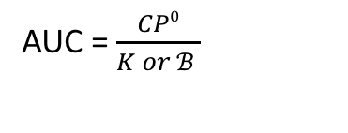
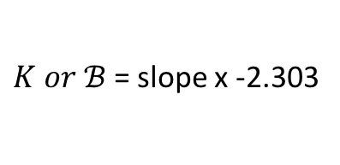
I.V. bolus (residual method)
Semilog paper
Slope = △Y/ △X
$K or ℬ$= slope x -2.303
AUC = $\frac{CP0}{K or ℬ }$

Slide 17
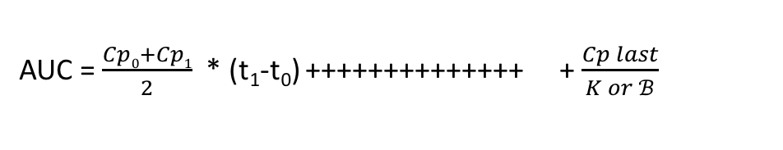
I.V. bolus (Trapezoidal method)
Regular paper
AUC = AUC1+ AUC2+ AUC₃+ AUC4+ AUC5 + AUC6 + AUC _{last}
AUC = $\frac{Cp0+Cp1}{2}$ * (t₁-t₀) ++++++++++++++ + $\frac{Cp last}{K or ℬ}$
From the residual method
Residual area

Slide 18
Extravascular route

Slide 19
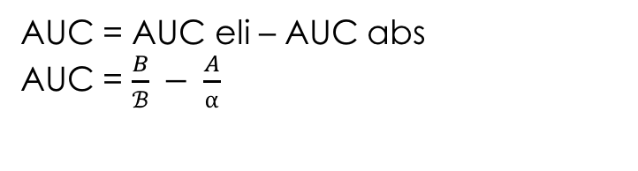
EXRRAVASCULAR (residual)
AUC = AUC eli – AUC abs
AUC = $\frac{B}{ℬ} − \frac{A}{⍺}$

Slide 20
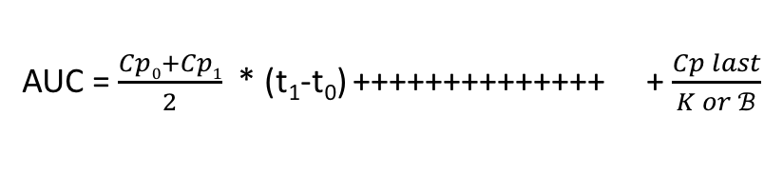
EXRRAVASCULAR (trapezoidal)
AUC = AUC1+ AUC2+ AUC₃+ AUC4+ AUC5 + AUC6 + AUC _{last}
AUC = $\frac{Cp0+Cp1}{2}$ * (t₁-t₀) ++++++++++++++ + $\frac{Cp last}{K or ℬ}$
From the residual method

Slide 21


